Slide 1
Intelligent parking system

Slide 2
contents
Abstract
Introduction
Related works
Detailed Design
References

Slide 3
Abstract
The goal of this project was to take a parking lot control system that is highly automated and reliable without the presence of man-power to control the parking.
We look forward to acquiring a secured parking spot in a very short time before heading out towards our destination in order to reduce the hassle of driving around looking for a parking spot.

Slide 4
introduction
In cities the majority of parking spaces is controlled by manpower.
Surprisingly hardly any data on usage of these spaces is available. This is changing rapidly.
Many cities and governments, in partnership with the industry, are currently developing and implementing programs to create smarter cities.
Parking data from city-centres are considered a prominent part of that.
With information from parking sensors it is easy to guide visitors, delivery drivers, taxi’s, workers and residents quickly to available parking spaces.

Slide 5
Related works
Prediction of parking space availability in real time
This systems allow customers to select a parking facility according to their preferences, rapidly park their vehicle without searching for a free stall, and pay their reservation in advance avoiding queues.
Felix Caicedo a, Carola Blazquez b, Pablo Miranda 2012 Elsevier Ltd
Determining the availability of parking spaces
This system is for determining and communication the availability of parking spaces. The system includes an Optical adapted to Scan a plurality of the Parking spaces and to produce scan data for the parking spaces scanned.
Jay H_ Ball, 11 Russell Cir” Natick, MA (Us) 01760 2011 US patent

Slide 6
Related works
Method and apparatus for detection and remote notification of vehicle parking space availability data
This system Provides timely and efficient notification of vehicle parking space availability and locations of vehicle parking spaces to motorists or other network users.
Josephp_Quinn,729AmericanLegion Hwy” Apt 1, Roshndale, M A (Us) 2012 US patent
Real-time Street Parking Availability Estimation
This system uses the GPS and/or accelerometer sensors in a traveler’s mobile phone to automatically detect when and where the traveler parked her car
Bo Xu⊥§ Ouri Wolfson§ Jie Yang§ Leon Stenneth§ Philip S. Yu§ Peter C. Nelson§ 2013 IEEE 14th International Conference on Mobile Data Management

Slide 7
Related works
Predictive analytics: parking prediction using sensors and gps.
This parking system that will be explained in this paper aims to combat that very nuisance of parking., By prediction the availability before hand.
Ojas Pandya 1 , Shiamak Mehta 2 , Hemant Jarkad 3 , Arti Mohanpurkar 4 International Conference on Advances in Engineering Science and Management, Agra, 08th November, 2015
Parking Availability Prediction for Sensor-Enabled Car Parks in Smart Cities
This system is predicting the parking occupancy rate using three feature sets with selected parameters to illustrate the utility of these features.
Yanxu Zheng, Sutharshan Rajasegarar, Christopher Leckie 2015 IEEE Tenth International Conference on Intelligent Sensors, Sensor Networks and Information Processing (ISSNIP) Singapore, 7-9 April 2015

Slide 8
Related works
Finding available parking spaces made easy
The parking lot regularly communicates the number of occupied spaces, capacity, arrival and parking rate through a vehicular network to find the free parking spaces.
Andreas Klappenecker 1, Hyunyoung Lee ,2, Jennifer L. Welch 3 2012 Elsevier B.V
Smart parking solutions for urban areas.
This system is mainly for easily finding parking spaces in busy cities without wasting fuel, time etc.…
Elena Polycarpou, Lambros Lambrinos 2013 IEEE.

Slide 9
Detailed design
Fig 1:System Architecture

Slide 10
Detailed design
INPUT FOR SENSOR TO THE MCU
When the sensor is LOW it means that the parking lot is empty.
When the sensor is HIGH it means that the car is present in the parking lot
This processing is done by the Microcontroller Unit
The Microcontroller unit processes the sensor input and stores the input values as 0 or 1 based on whether LOW OR HIGH.
The type of sensor used is an infrared proximity sensor.
The obtained values are stored in a file to be used later for processing.

Slide 11
Detailed design
readIR( ){ while(true) { a =(IRemitter,LOW); // turning the IR LEDs off to read the IR coming from the ambient ambientIR = a; // storing IR coming from the ambient b = (IRemitter,HIGH); // turning the IR LEDs on to read the IR coming from the obstacle obstacleIR = b // storing IR coming from the obstacle i }
}

Slide 12
Detailed design
This is a arbitrary example of parking lots, consider it to be in this from for the following explanation.
Let us consider this 3x3 board as a 9-space parking lot just for computation purposes
There are two sensors to be fixed in every lot
One at the front and another at the side
Infrared proximity sensors are to be used.
Output status from the sensor.
0 – No car
1 - Lot is occupied by the car
Fig 2:lot is identified uniquely by it’s id.

Slide 13
Detailed design
We are coming to a assumption that only if both sensors say that there interruption, we are coming to a conclusion of the lot is free .
Let us consider there are two IR proximity sensor for each parking lot. Let they be s1 and s2.
Only if both s1 and s2 are HIGH (s1=1 and s2=1 ), then a car is available in the parking lot.
Fig 3:Sensor output logic

Slide 14
Detailed design
The data obtained from the sensor is in the following manner:
struct SensorData
{
int id;
bool s;//either 0 or 1
}

Slide 15
Detailed design
The sending structure is:
struct Data
{
bool x; // this is the AND of the two sensors in the parking lot
}

Slide 16
Detailed design
Now after the MCU processes the data , a TCP connection is open between the MCU and the server.
Via this connection , the required packet is sent to the server which carries the information regarding the parking lot availability.
Received data is stored in the database.
Then these values or used in determining the parking availability and mapping it onto a web interface to be displayed.

Slide 17
ERROR cases
Multiple people trying to park their car inn the same lot leading to confusion.
In case of an error condition where a sensor is obstructed by an obstacle other than a car, a distance calculation is done for the proximity sensor. Only if the distance between the sensor and the object is greater than a particular distance, only then the obstacle is a car
For(till n){
value=ambientIR-objectIR
distance+=value
}
If(distance> d)
then valid object

Slide 18
MODULES
SENSOR_SYSTEM
DATA_RECEPTION

Slide 19
Sensor system Module Pseudo-code
MCU_STATE = CALL MCU
SENSOR_STATE = Call SENSOR
WHILE(MCU_STATE = 1 && SENSOR_STATE = 1 ){
Get the SENSORDATA
Send the SENSORDATA to Server wirelessly
Receive RESPONSE_FROM_SERVER
WHILE (RESPONSE_FROM_SERVER = NOT_RECEIVED)
RESEND THE DATA
}

Slide 20
DATA_RECEPTION Module Pseudo-code
...........................
IF REQUEST_RECEIVED
VERIFY THE DATA_RECEIVED
IF DATA_RECEIVED == 1 or DATA_RECEIVED == 0
STORE THE RECEIVED DATA IN DATABASE
RETURN THE RESPONSE
ELSE
RETURN NOT_RECEIVED AS RESPONSE
END
END
...........................

Slide 21
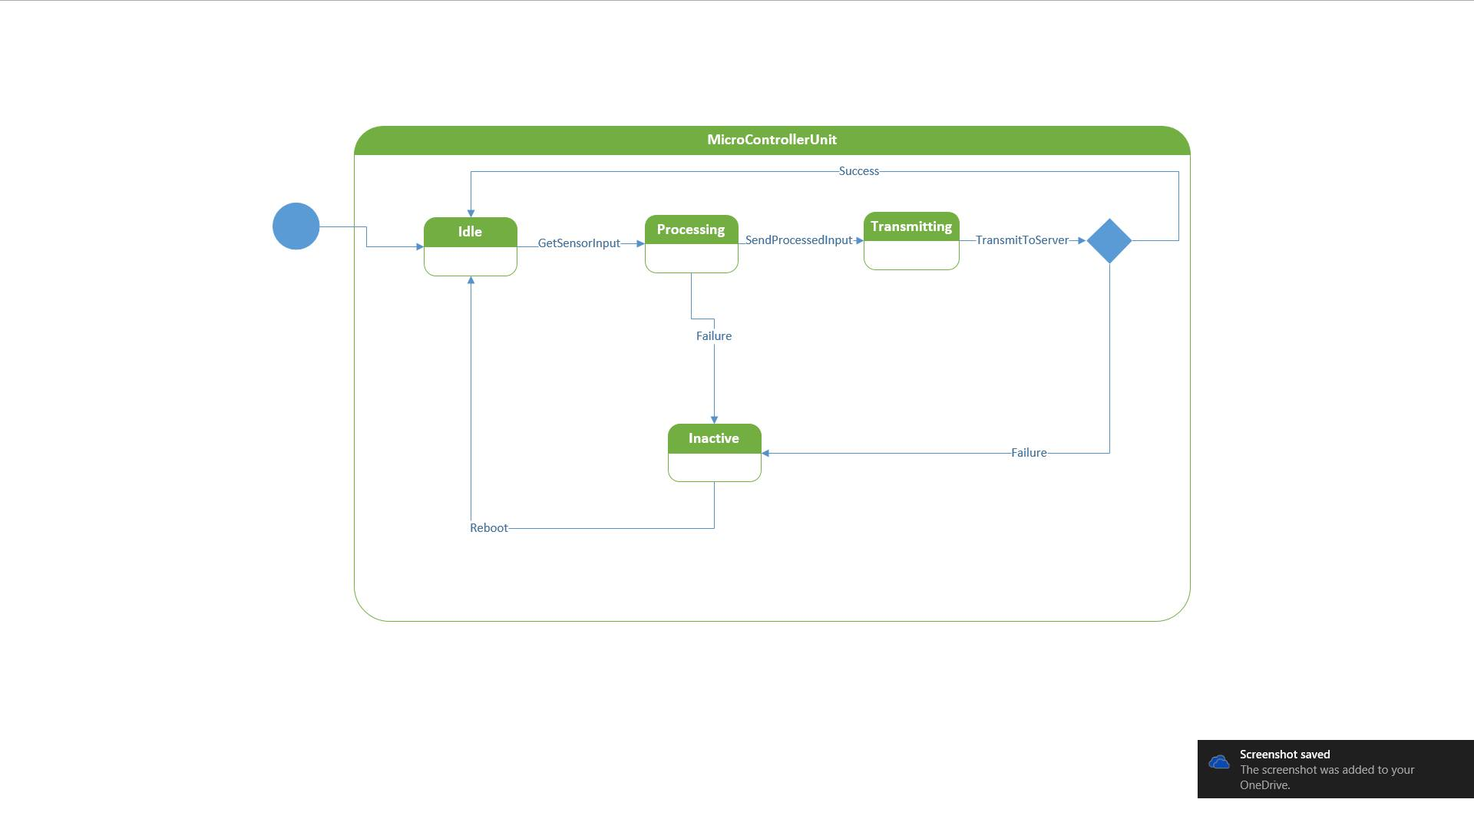
Input : Sensor data.
Output : Collaborated Sensor data. (Transfers data from sensor to server.)
Notes:
Input : Sensor data.
Output : Collaborated Sensor data. (Transfers data from sensor to server.)

Slide 22
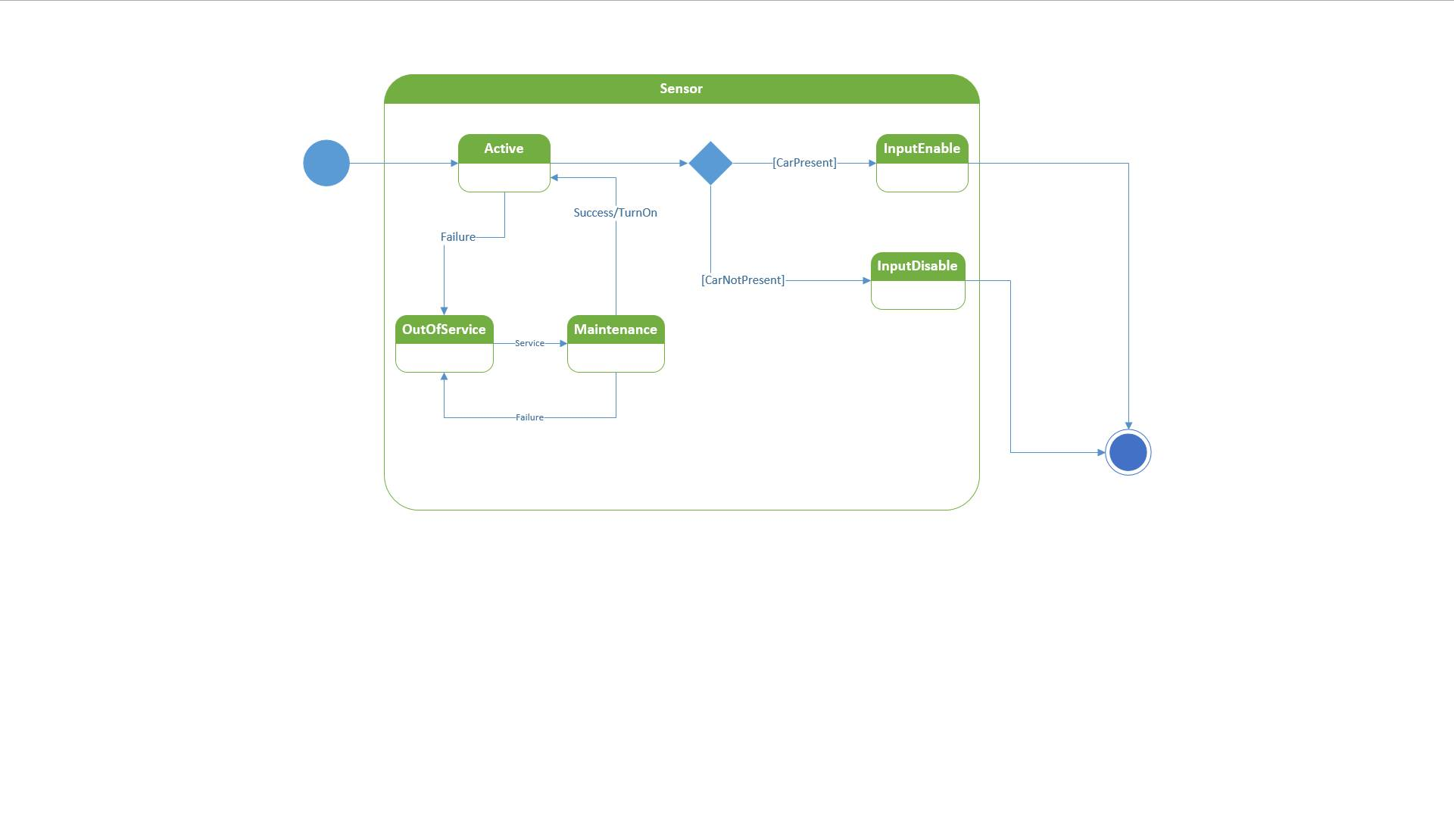
Input : Parking availability sensed by sensor from parking lot(presence or absence of car).
Output : Processed data to microcontroller unit.
Notes:
Input : Parking availability sensed by sensor from parking lot(presence or absence of car).
Output : Processed data to microcontroller unit.

Slide 23
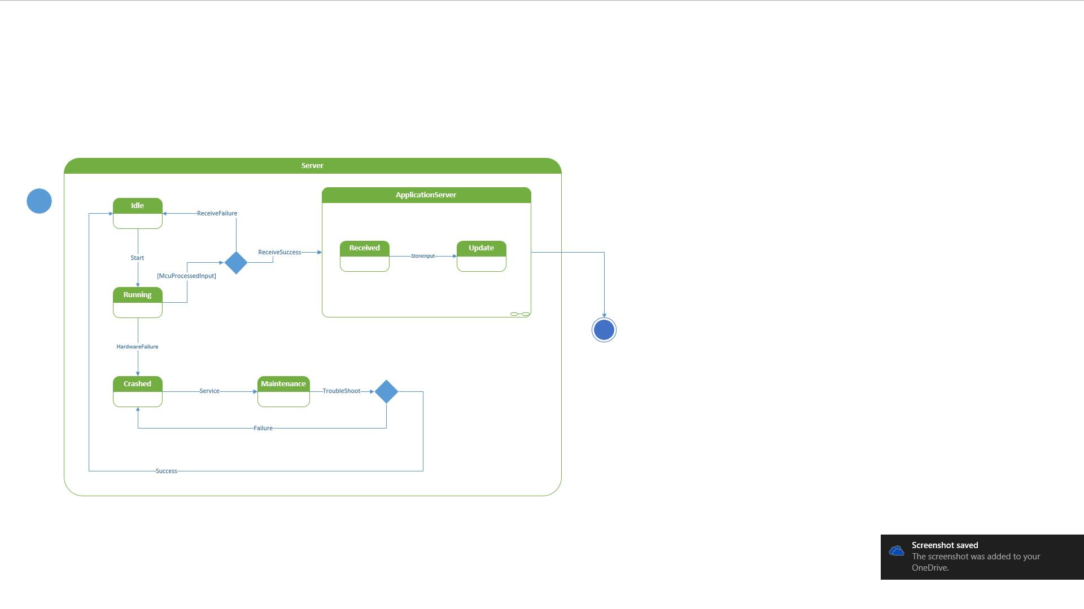
Input : Data from microcontroller at particular intervals.
Output : Processed database to Display.
Notes:
Input : Data from microcontroller at particular intervals.
Output : Processed database to Display.

Slide 24
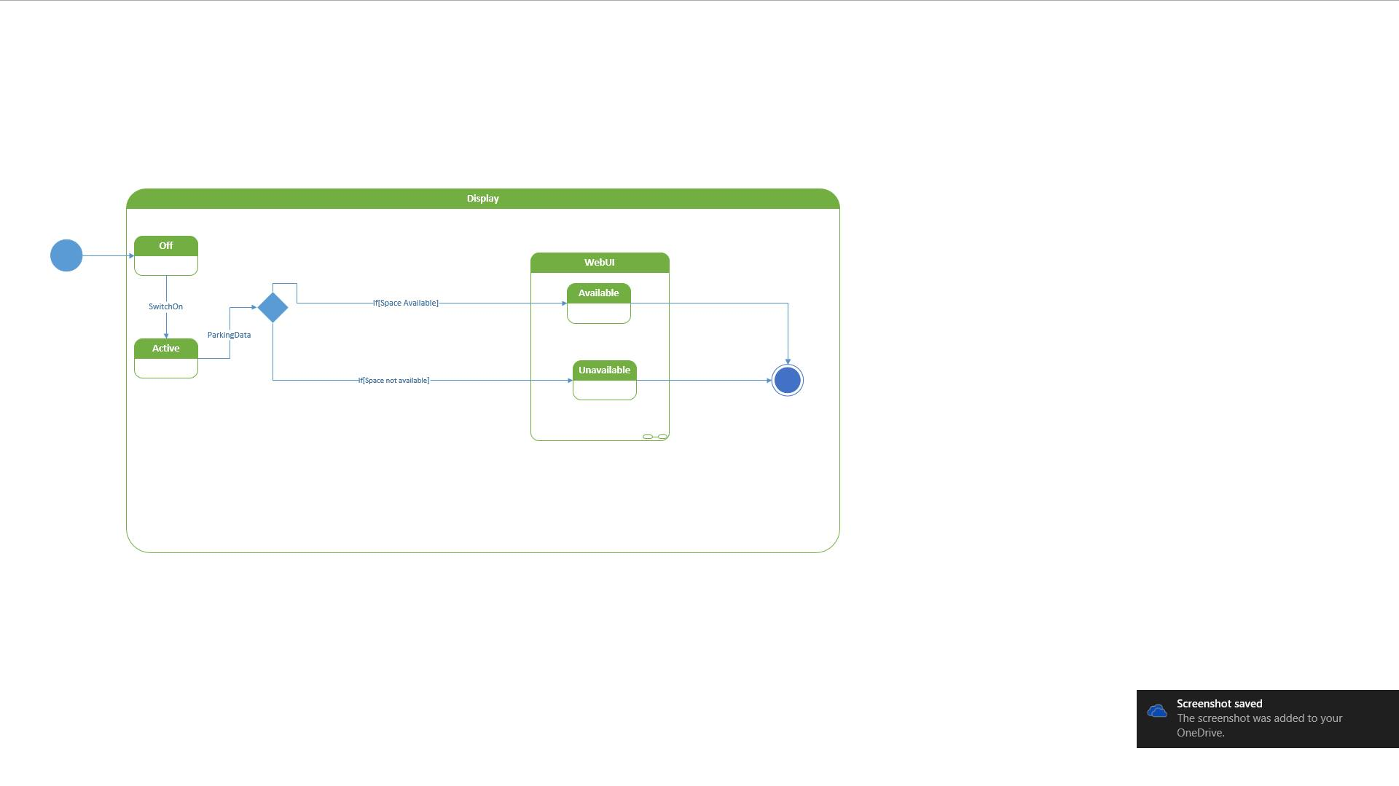
Input : Data from server.
Output : Display the data
Notes:
Input : Data from server.
Output : Display the data

Slide 25
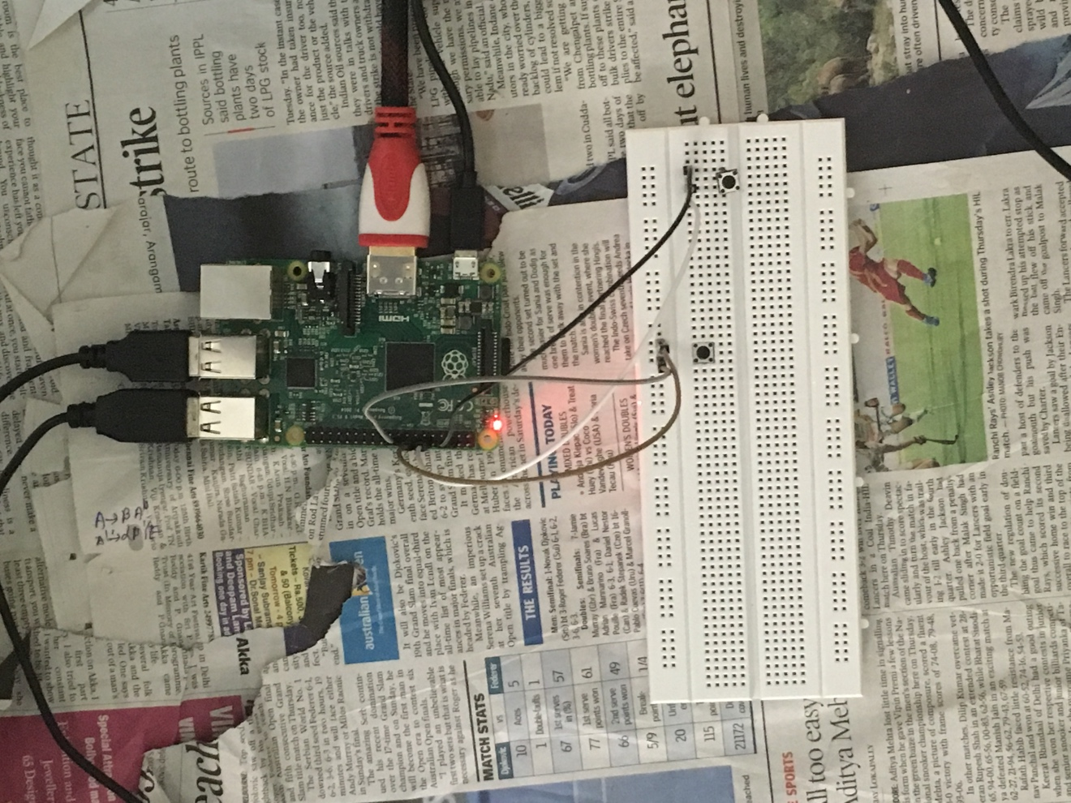
Implementation

Slide 26
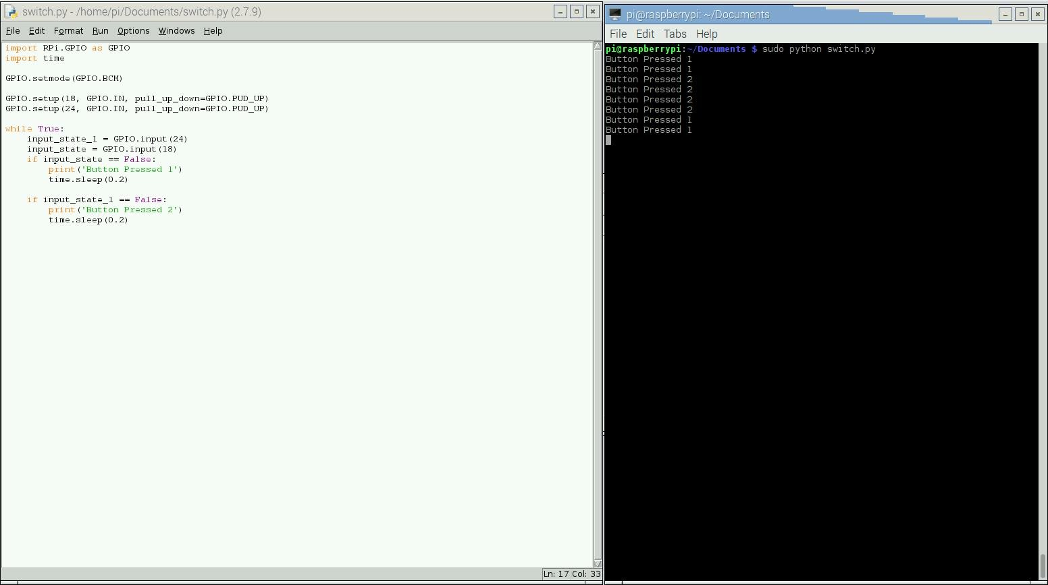
Implementation

Slide 27
Evaluation parameters
Construction
This system consists of sensor output processed by the control unit and sent to display for easy understanding to end users.
Accuracy
In this system, every parking lot consists of individual sensors and the structure is simple so the output will be accurate. The accuracy of the sensors is the most important factor.
Reliability
This system is mainly constructed for replacement of man power, so it has to be reliable, we have taken care of test cases like one sensor is showing there is a car and another is showing not, and there should be frequent inspection of sensors.

Slide 28
Evaluation parameters
Accessibility
The end user is just exposed to the display system, which just displays the free lots and they are hidden from the internal structure of the system, so it’s easily accessible.
Open to changes
The system is just in initial stage of development and there are many modules in which we can bring in change sin the future. Such changes can be like automating the parking bill procedure along with parking it.
Robustness
This can be ensured by protecting the hardware like the sensors , the MCU and server from physical damage and crashing

